Slide 1
How Volunteers Can Impact Patient Safety
Saint Francis Medical Center

Slide 2
How Volunteers Can Impact Patient Safety
Falls occur at a rate of 700,000- 1,000,000 each year in hospitals across the Country
Research suggests that one-third (1/3) of these falls can be prevented
We want to provide quality healthcare that keeps patient safe
We want to decrease overall Healthcare costs
Volunteers can help keep patients safe

Slide 3
History/Development
Attended a session at the AHVRP Conference in Fall of 2016 on Volunteers Impacting safety from Cooper University Health care.
Met with Service Excellence director to determine feasibility
Met with CNE and Nursing ADs in January of 2017 to present a PowerPoint as a proposal to start a similar program at SFMC
Discussed ways the Volunteer Department would assist the Nursing Staff in preventing falls.
ADs agreed to move forward to set up a pilot program.
Although it was initially determined to start on the smaller PCU unit, eventually the pilot was started on the Orthopedic floor where a largest number of falls had occurred.

Slide 4
History/Development
A nurse educator agreed to collaborate with Volunteer services to develop a training session with training materials and tools.
A number of meetings occurred with the Nurse educator to work on developing Volunteer friendly training materials.
There were several months of delays due to the fact that a new Fall prevention policy was being developed across The Health Care System
Initially Recruited volunteers internally who were already working on the units and that I knew felt comfortable working on the units.
4 Volunteers were initially recruited to participate in the pilot program

Slide 5
Fall Prevention Training
Once training materials were developed, a training session for volunteers was planned and held on May 2, 2017. 4 volunteers were trained.
The Training consisted of 2 hours of classroom training. The training included:
Rationale for the program including stats on falls in hospitals across the US
An explanation and purpose of the program
Program goals-10% reduction in in falls on that unit
Review of program components/ Volunteer responsibilities.
Review of Hand Hygiene & HIPAA

Slide 6
Fall Prevention Training
Training in AIDET (Acknowledge, Introduce, Duration, Explanation, Thank you)
Responsibilities of the volunteers include:
Environment of Care rounds
Checking and tracking fall precautions to see if they were in place.
Simple education for the patient/and or family member when appropriate
In addition to the required classroom training 2 hours of shadowing time with the Nurse educator was required ( 1:1 or 1:2)

Slide 7
Fall Prevention Training
Volunteers are instructed to ask for a list from the charge nurse on the unit when they arrive. They visit with patients who are rated on the Schmidt scale( fall risk assessment) of 3 or higher
Tools utilized include the bedside Fall Collection Tool and an easy to understand brochure to give to the patient/and or family members when appropriate
Volunteers were trained on how to correctly collect data and how to obtain assistance from clinical staff when needed to correct fall precautions not in place ( bed alarms, etc.)
Volunteers are instructed to ask for a list from the charge nurse on the unit when they arrive. They visit with patients who are rated on the Schmidt scale of 3 or higher.
Results on the Ortho Floor to date seem to be positive

Slide 9
Saint Francis Medical Center Volunteer Fall Data Collection Tool
Volunteer Name: ___________________________________ Date: ________________________
Unit: _________________________ # Pt. seen today_____ # Pt. Fall Risk__________
(# Patients with Fall Risk of 3 and above on unit)
Last Name & Room # | Door Fall sign visible? | WB Fall Sign Use? | Call Bell in reach? | Possession in reach? Glasses, tissues, water, etc. | Yellow Risk Band On? | Yellow Non-slip socks on? | Gait Belt in room? | Bed in low position? ** | # Side rails up? ** | Bed (B) OR Chair (C) alarm use? **
1) | Y N | Y N | Y N | Y N | Y N | Y N | Y N | Y N | 0 1 2 3 4 | C Y N B
2) | Y N | Y N | Y N | Y N | Y N | Y N | Y N | Y N | 0 1 2 3 4 | C Y N B
3) | Y N | Y N | Y N | Y N | Y N | Y N | Y N | Y N | 0 1 2 3 4 | C Y N B
4) | Y N | Y N | Y N | Y N | Y N | Y N | Y N | Y N | 0 1 2 3 4 | C Y N B
5) | Y N | Y N | Y N | Y N | Y N | Y N | Y N | Y N | 0 1 2 3 4 | C Y N B
6) | Y N | Y N | Y N | Y N | Y N | Y N | Y N | Y N | 0 1 2 3 4 | C Y N B
7) | Y N | Y N | Y N | Y N | Y N | Y N | Y N | Y N | 0 1 2 3 4 | C Y N B
8) | Y N | Y N | Y N | Y N | Y N | Y N | Y N | Y N | 0 1 2 3 4 | C Y N B
** These areas require immediate attention-contact PCT or nurse/ Only collect data where patient is located ( bed/chair)

Slide 10
Education Provided? If yes, to whom? | Did you contact Nursing Staff immediately for starred items? Please indicate which item. If you did not contact staff right away indicate why. | Use this space to explain any issues.
1)
2)
3)
4)
5)
6)
7)
8)
**- contact clinical staff for assistance immediately for starred items in bold box

Slide 13
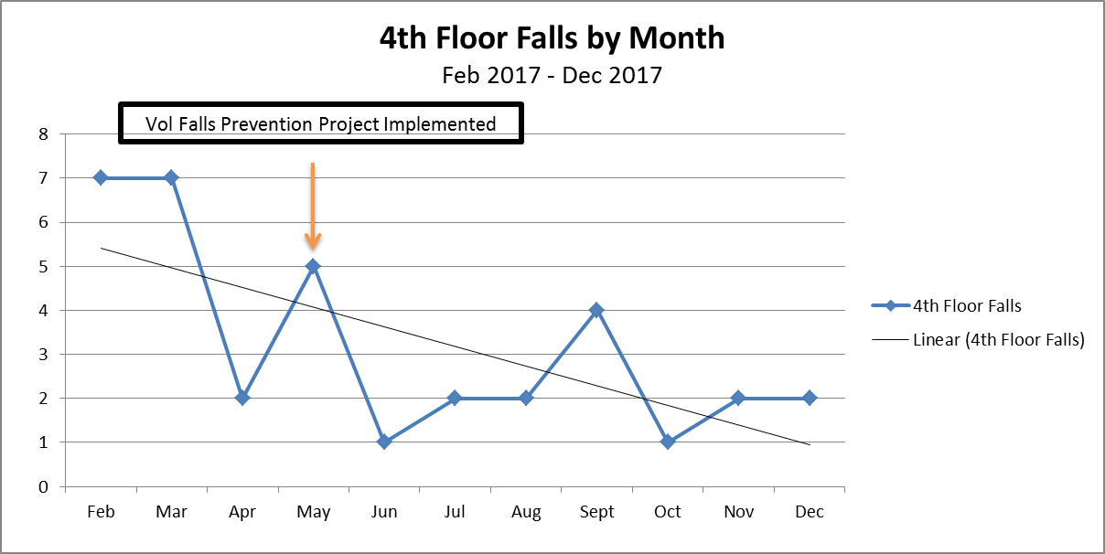
SFMC 4th Floor Fall Rate
Notes:
Agency for Healthcare Research and Quality - https://www.ahrq.gov/professionals/systems/hospital/fallpxtoolkit/index.html

Slide 14
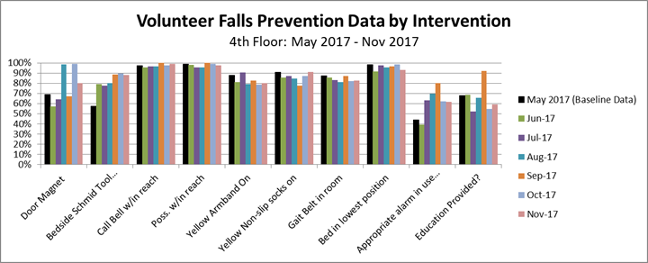
Volunteer Falls Prevention Data Collection: 4th floor

Slide 15
Future Direction & Continued Expansion
Meetings held in August with Key Nursing staff and later Volunteers to review the program. In addition volunteers provide ongoing feedback to director which has helped help improve protocols.
Based on positive feedback from staff and due to an increase in falls on the Med Surg Unit, it was requested that the program roll out to the 5th floor
Based on initial experiences, it was determined that a one page flyer be developed to inform staff of the roll out would occur 1 week prior to the program starting. The new program was explained by clinical lead staff in huddles.
Both the director and a Fall Prevention Volunteer serve on the Hospital Falls Committee to provide input.
Period meetings are held to hear input from the volunteers, review trends & issues and make changes to the protocol as needed.

Slide 16
Continued Expansion, Future Direction &
Volunteers were recruited both internally and externally based on skills and interests.
A second Volunteer Fall prevention training for Volunteers to work on the Med Surg unit was held on October 24th, 2017
Volunteers working on the Med Surg unit began the first week of November, 2017.
Materials for this program include: A training packet, a job description, A falls data collection tool, a fall risk patient educational flyer and a fall prevention program flyer for unit staff.
Volunteers recruited to input data from Fall data collection tool.
A meeting to review the program as well as results and impact will be held in April.
DF/1/22/18

Slide 18
Benefits of the Program
Reduction of Patient falls
Support to clinical staff through daily checks
Analysis of trends-successes and opportunities
Provides data that can determine educational needs and strategies
Align with Hospital Patient safety Goals-Volunteer Services seen as a critical part of the Hospital team
KEEPS PATIENTS SAFER!

Slide 19
What Questions Do You Have?

